Slide 1
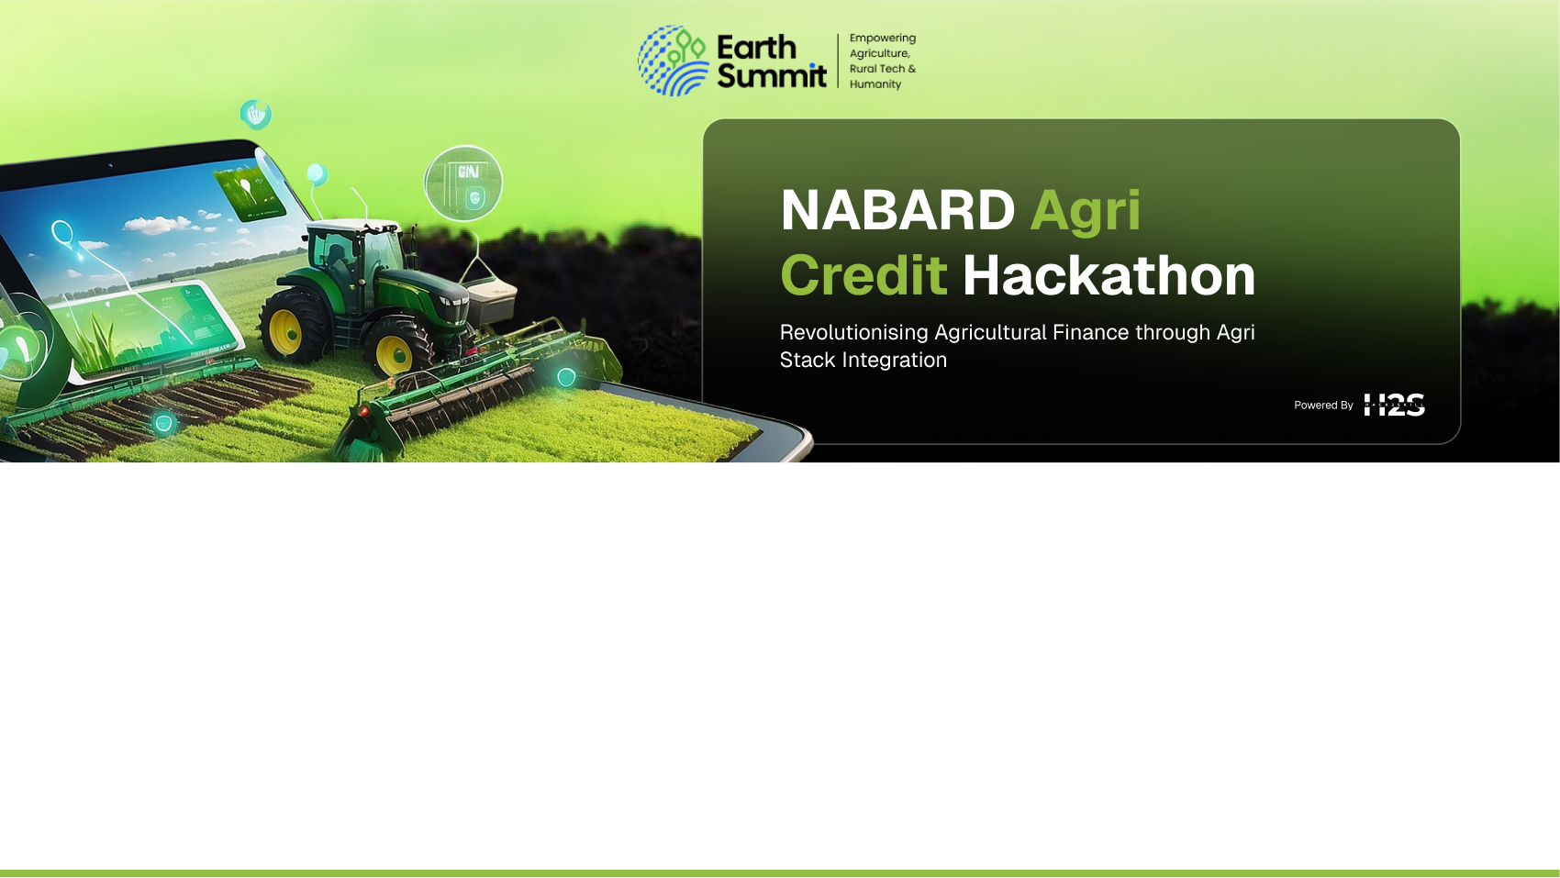
Team Details
  Team name: AgriFin Innovators
  Team leader name: Sudarshanam Yessasvini
  Problem Statement: Landless and tenant farmers, who cultivate over 30% of India’s farmland, are excluded from formal credit systems due to lack of land ownership and collateral. This results in heavy dependence on informal moneylenders at exploitative interest rates, perpetuating rural debt and inequality.

Slide 2
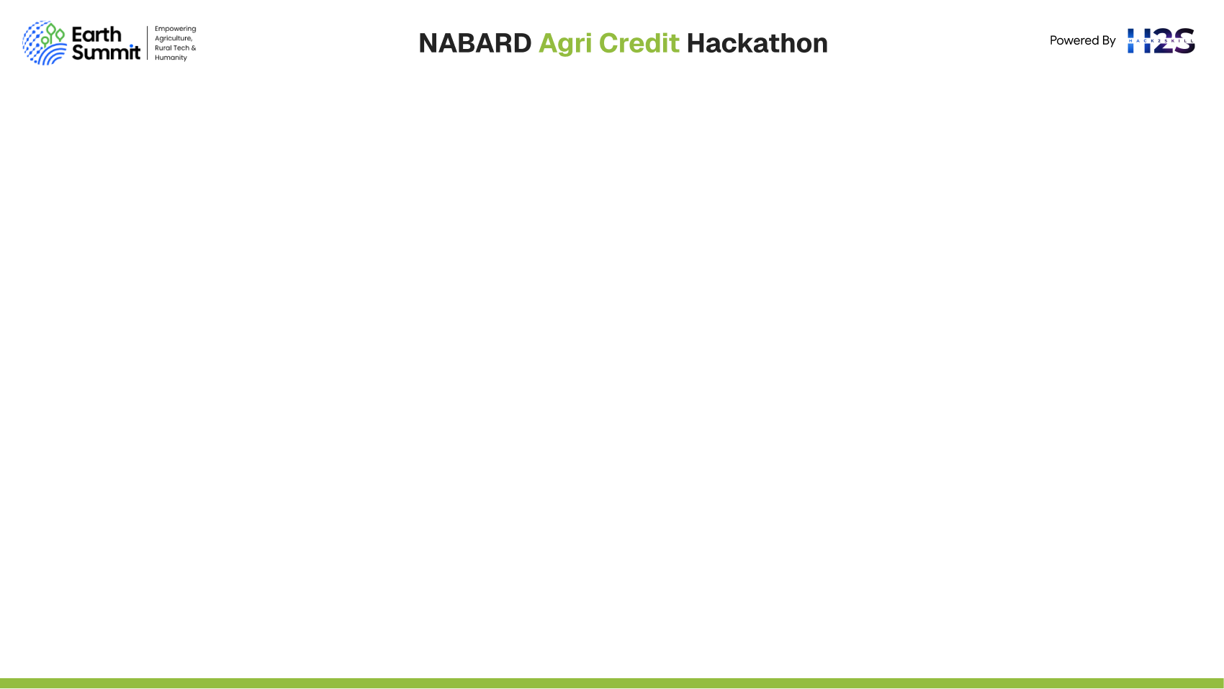
Brief about the idea
DhartiKrishi-Sahayata is an AI-powered platform that builds a digital, collateral-free credit identity for tenant farmers and sharecroppers using Agri Stack, satellite NDVI, and alternative transaction data.
It generates a dynamic, explainable Tenant Farmer Credit Score (TCS), enabling banks and NBFCs to safely extend loans to previously unbanked farmers.
The platform integrates farmer onboarding, credit scoring, real-time monitoring, and risk alerts into a seamless system for financial institutions.

Slide 3
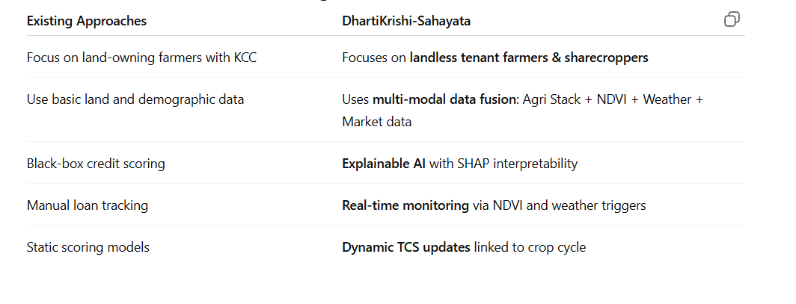
Opportunities:
3+ crore tenant farmers in India are invisible to formal credit systems.
Estimated $15 billion untapped agri-lending opportunity.
Supports national priorities of financial inclusion, Agri Stack adoption, and digital credit enablement.
Aligns with NABARD’s goal of improving rural credit access using AI and satellite data.
How Different Is It from Existing Solutions:

Slide 4
How It Solves the Problem:
For Farmers: Provides access to fair, collateral-free credit, helping escape informal lending cycles.
For Lenders: Enables entry into a new low-risk agri-lending segment through AI-backed credit scoring.
For NABARD/Government: Achieves true financial inclusion using Agri Stack and AI for data-driven policymaking.
The solution transforms the “invisible” farmer into a visible, credit-eligible entity using a combination of verified identity, land usage, and satellite-derived performance indicators.
USP (Unique Selling Proposition):
Tenant Farmer Credit Score (TCS):
Proprietary AI model designed for farmers without land collateral.
Dynamic Scoring Engine:
Real-time updates using NDVI crop health and weather insights.
Explainable AI (XAI):
Transparent risk reports for lenders, increasing trust.
Ecosystem Ledger:
Immutable digital record of landlord-tenant contracts and repayments.
Agri Stack Integration:
End-to-end validation through Farmer ID, crop data, and advisory layers.

Slide 5
List of features offered by the solution
📱 Farmer Onboarding: Aadhaar e-KYC, tenancy declaration via app/USSD.
🌐 Data Fusion Engine: Combines Agri Stack, satellite, mandi, and input supplier data.
🧮 TCS API: AI-generated credit score + explainability report.
🏦 Lender Dashboard: Portfolio view, loan review, and risk alerts.
🔔 Real-Time Alerts: NDVI-based crop stress and harvest detection.
💰 Automated Loan Lifecycle: Origination → Disbursement → Monitoring → Collection.
📊 Analytics Suite: For NABARD/Bank to track impact and risk.

Slide 6
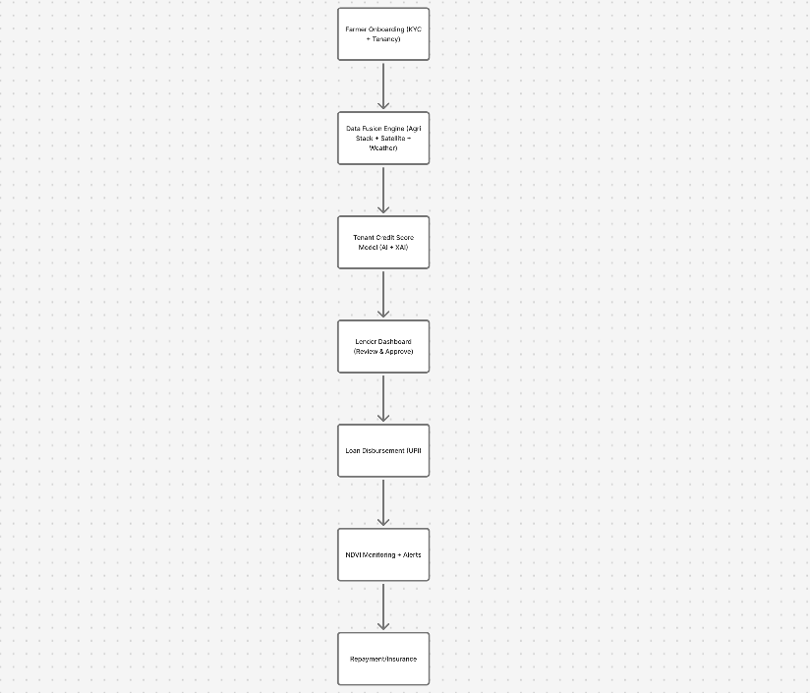
Process flow diagram or Use-case diagram

Slide 7
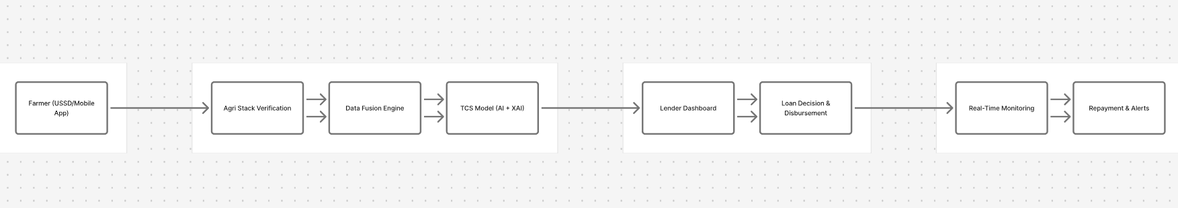
Wireframes/Mock diagrams of the proposed solution (optional)

Slide 8
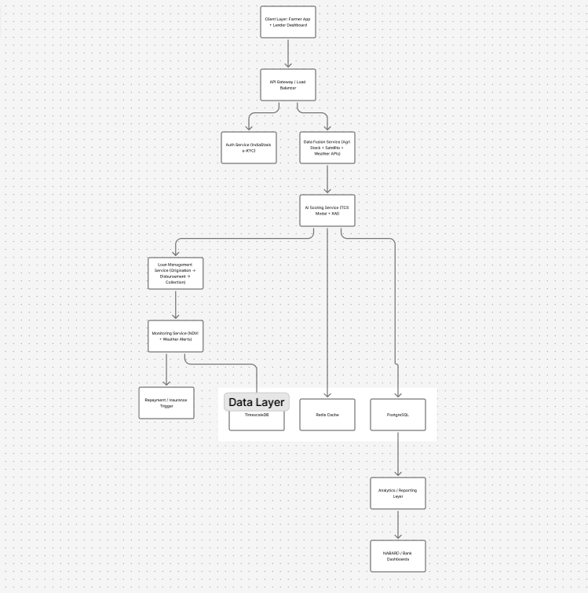
Architecture diagram of the proposed solution

Slide 9
Technologies to be used in the solution
Technologies UsedAI/ML: PyTorch, XGBoost, SHAP,
MLflowBackend: FastAPI, Celery,
GraphQLFrontend: React.js (Dashboard),
Flutter (Farmer App)Database: PostgreSQL, TimescaleDB,
RedisCloud: AWS EC2, S3,
EKSIntegrations: Agri Stack (FaaS), IndiaStack (e-KYC/eSign), IMD Weather API, UPI

Slide 10
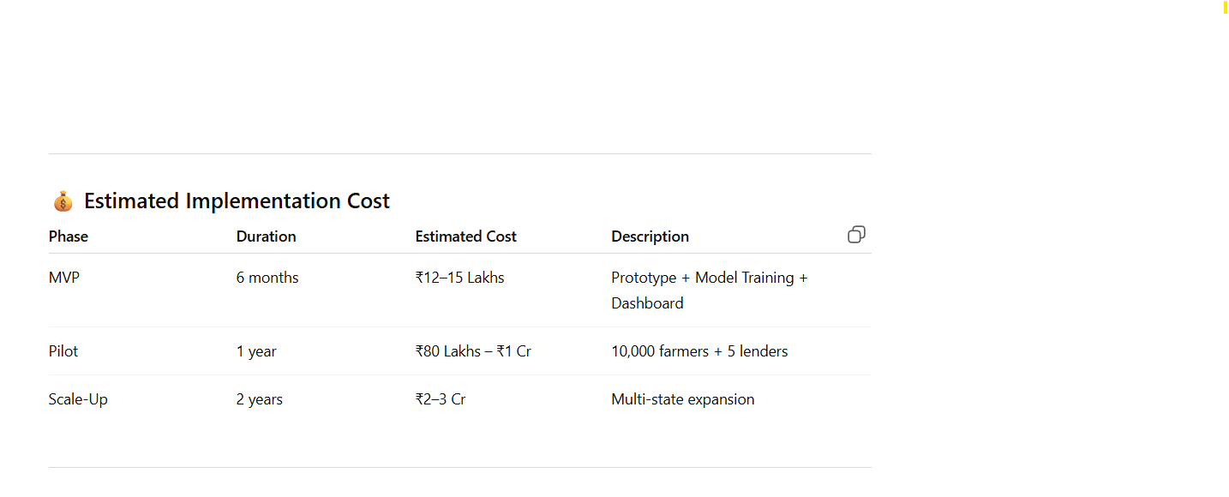
Estimated implementation cost (optional)

Slide 11
Type here…

Slide 12
